Slide 1
Blacktown Chinese Christian Church
Welcome to Our English Service 16.03.2025
English Service 9:45 – 11:00 am
Worship Songs: Passage: Speaker: Topic: Response Song: Announcements and Closing Prayer Benediction
Blessed Assurance (CityAlight) Amazing Grace (My Chains Are Gone) Whom Shall I Fear Genesis 25:20-26 Genesis 32:22-32A TBA TBA TBA

Slide 2
BCCC english service

Slide 3

Please keep all phones on silent

Slide 4
Blessed Assurance
Jaywan Maxwell, Michael Farren, Nathan Singh, Rhyan Shirley ©2016 CityAlight Music (Admin. by Integrity Music) CCLI Licence No. 5485849. CCLI Song number: 22324

Slide 5
Verse 1
All my attempts to be satisfied were vain and empty
Until the moment You rescued me and Your love filled me
My soul sings
Now my soul sings

Slide 6
Chorus
What blessed assurance
I've found in You, I've found in You
I won't be shaken, I will not be moved

Slide 7
Chorus
How steadfast Your strong hand
Is keeping me, is keeping me
I won't be shaken, I will not be moved
O blessed assurance

Slide 8
Verse 2
No other love that I've ever known
Compares to You, God
No other love that I've ever found
Has done what You've done

Slide 9
Verse 2
My soul sings
Now my soul sings

Slide 10
Chorus
What blessed assurance
I've found in You, I've found in You
I won't be shaken, I will not be moved

Slide 11
Chorus
How steadfast Your strong hand
Is keeping me, is keeping me
I won't be shaken, I will not be moved
O blessed assurance

Slide 12
Bridge
Ever my anchor, ever my strength
Ever my portion, and all I need

Slide 13
Bridge
Ever my healing, ever my hope
Ever the truth that leads me home
That leads me home

Slide 14
Chorus
What blessed assurance
I've found in You, I've found in You
I won't be shaken, I will not be moved

Slide 15
Chorus
How steadfast Your strong hand
Is keeping me, is keeping me
I won't be shaken, I will not be moved
O blessed assurance

Slide 16
Chorus
What blessed assurance
I've found in You, I've found in You
I won't be shaken, I will not be moved

Slide 17
Chorus
How steadfast Your strong hand
Is keeping me, is keeping me
I won't be shaken, I will not be moved
O blessed assurance

Slide 18
Amazing Grace (My Chains Are Gone)
Chris Tomlin, John Newton, Louie Giglio ©2006 Rising Springs Music (Admin. by SHOUT! Music Publishing Australia) Vamos Publishing (Admin. by SHOUT! Music Publishing Australia) worshiptogether.com songs (Admin. by SHOUT! Music Publishing Australia) CCLI Licence No. 5485849. CCLI Song number: 4768151

Slide 19
Verse 1
Amazing grace, how sweet the sound
That saved a wretch like me
I once was lost, but now I'm found
Was blind, but now I see

Slide 20
Verse 2
'Twas grace that taught my heart to fear
And grace my fears relieved
How precious did that grace appear
The hour I first believed

Slide 21
Chorus
My chains are gone, I've been set free
My God, my Savior has ransomed me
And like a flood His mercy reigns
Unending love, amazing grace

Slide 22
Verse 3
The Lord has promised good to me
His word my hope secures
He will my shield and portion be
As long as life endures

Slide 23
Chorus 1
My chains are gone, I've been set free
My God, my Savior has ransomed me
And like a flood His mercy reigns
Unending love, amazing grace (x2)

Slide 24
Verse 4
The earth shall soon dissolve like snow
The sun forbear to shine
But God who called me here below
Will be forever mine

Slide 25
Verse 4
Will be forever mine
You are forever mine

Slide 26
Whom Shall I Fear
CCLI Licence No: 5485849

Slide 27
Verse 1
You hear me when I call
You are my morning song
Though darkness fills the night
It cannot hide the light

Slide 28
Verse 1
Whom shall I fear?

Slide 29
Verse 2
You crush the enemy
Underneath my feet
You are my sword and shield
Though troubles linger still

Slide 30
Verse 2
Whom shall I fear?

Slide 31
Chorus
I know who goes before me
I know who stands behind
The God of angel armies
Is always by my side

Slide 32
Chorus
The one who reigns forever
He is a friend of mine
The God of angel armies
Is always by my side

Slide 33
Verse 3
My strength is in your name
For you alone can save
You will deliver me
Yours is the victory

Slide 34
Verse 3
Whom shall I fear?
Whom shall I fear?

Slide 35
Chorus
I know who goes before me
I know who stands behind
The God of angel armies
Is always by my side

Slide 36
Chorus
The one who reigns forever
He is a friend of mine
The God of angel armies
Is always by my side

Slide 37
Bridge
And nothing formed against me shall stand
You hold the whole world in your hands
I'm holding on to your promises

Slide 38
Bridge
You are faithful
You are faithful

Slide 39
Bridge
Nothing formed against me shall stand
You hold the whole world in your hands
I'm holding on to your promises

Slide 40
Bridge
You are faithful
You are faithful
You are faithful

Slide 41
Chorus
I know who goes before me
I know who stands behind
The God of angel armies
Is always by my side

Slide 42
Chorus
The one who reigns forever
He is a friend of mine
The God of angel armies
Is always by my side

Slide 43
Chorus
I know who goes before me
I know who stands behind
The God of angel armies
Is always by my side

Slide 44
Chorus
The one who reigns forever
He is a friend of mine
The God of angel armies
Is always by my side

Slide 45
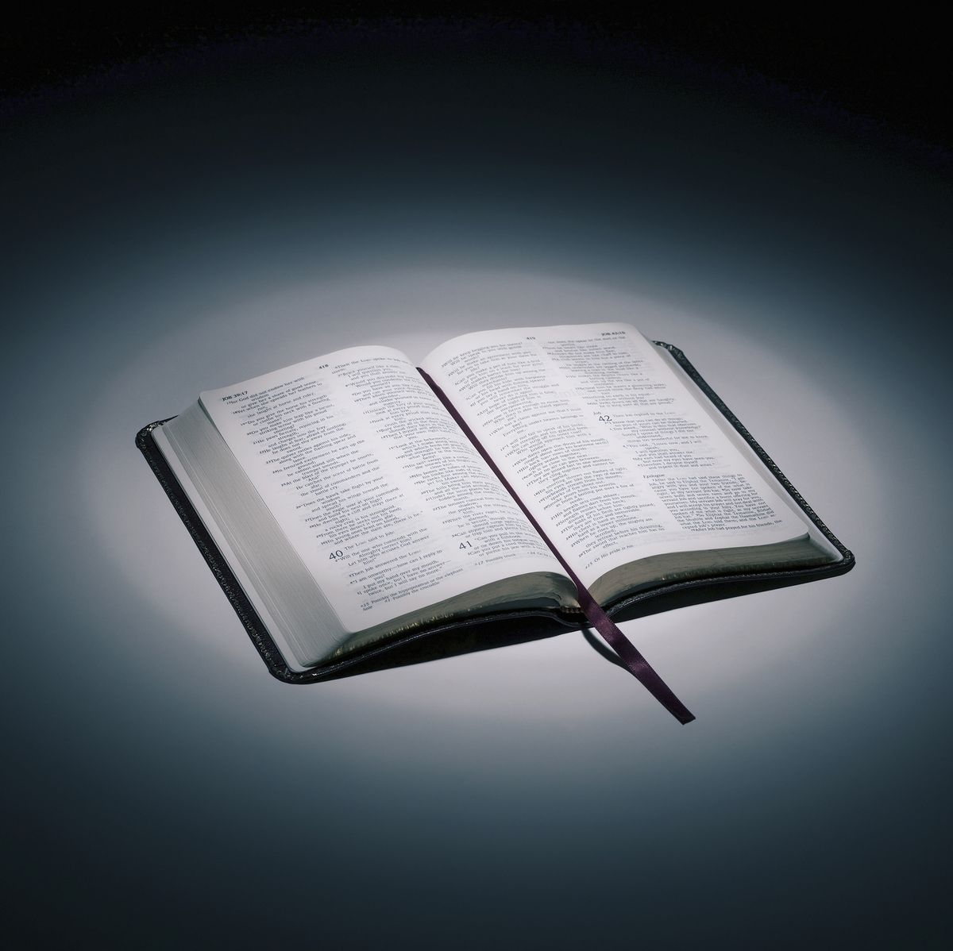
Bible reading

Slide 46
Genesis 25:20-26 (NLT)
²⁰ When Isaac was forty years old, he married Rebekah, the daughter of Bethuel the Aramean from Paddan-aram and the sister of Laban the Aramean.
²¹ Isaac pleaded with the Lord on behalf of his wife, because she was unable to have children. The Lord answered Isaac’s prayer, and Rebekah became pregnant with twins.

Slide 47
Genesis 25:20-26 (NLT)
²² But the two children struggled with each other in her womb. So she went to ask the Lord about it. “Why is this happening to me?” she asked.
²³ And the Lord told her, “The sons in your womb will become two nations. From the very beginning, the two nations will be rivals. One nation will be stronger than the other; and your older son will serve your younger son.”

Slide 48
Genesis 25:20-26 (NLT)
²⁴ And when the time came to give birth, Rebekah discovered that she did indeed have twins! ²⁵ The first one was very red at birth and covered with thick hair like a fur coat. So they named him Esau.

Slide 49
Genesis 25:20-26 (NLT)
²⁶ Then the other twin was born with his hand grasping Esau’s heel. So they named him Jacob. Isaac was sixty years old when the twins were born.

Slide 50
Genesis 32:22-32A (NLT)
²² During the night Jacob got up and took his two wives, his two servant wives, and his eleven sons and crossed the Jabbok River with them. ²³ After taking them to the other side, he sent over all his possessions.

Slide 51
Genesis 32:22-32A (NLT)
²⁴ This left Jacob all alone in the camp, and a man came and wrestled with him until the dawn began to break. ²⁵ When the man saw that he would not win the match, he touched Jacob’s hip and wrenched it out of its socket.

Slide 52
Genesis 32:22-32A (NLT)
²⁶ Then the man said, “Let me go, for the dawn is breaking!”
But Jacob said, “I will not let you go unless you bless me.”
²⁷ “What is your name?” the man asked.
He replied, “Jacob.”

Slide 53
Genesis 32:22-32A (NLT)
²⁸ “Your name will no longer be Jacob,” the man told him. “From now on you will be called Israel, because you have fought with God and with men and have won.”
²⁹ “Please tell me your name,” Jacob said.
“Why do you want to know my name?” the man replied. Then he blessed Jacob there.

Slide 54
Genesis 32:22-32A (NLT)
³⁰ Jacob named the place Peniel (which means “face of God”), for he said, “I have seen God face to face, yet my life has been spared.” ³¹ The sun was rising as Jacob left Peniel, and he was limping because of the injury to his hip.

Slide 55
Genesis 32:22-32A (NLT)
³² (Even today the people of Israel don’t eat the tendon near the hip socket because of what happened that night when the man strained the tendon of Jacob’s hip.)

Slide 56
Scripture quotations are taken from the Holy Bible, New Living Translation, Copyright © 1996, 2004, 2015 by Tyndale House Foundation. Used by permission of Tyndale House Publishers, Inc., Carol Stream, Illinois 60188. All rights reserved.

Slide 57
Announcements

Slide 58





Account name: Blacktown Chinese Christian Church
Account number: 4216 50263
Offering
BSB: 112 - 879
Please put in "offering" as the reference
The offering box is available at the back of the hall

Slide 59
Prayer points

Slide 60
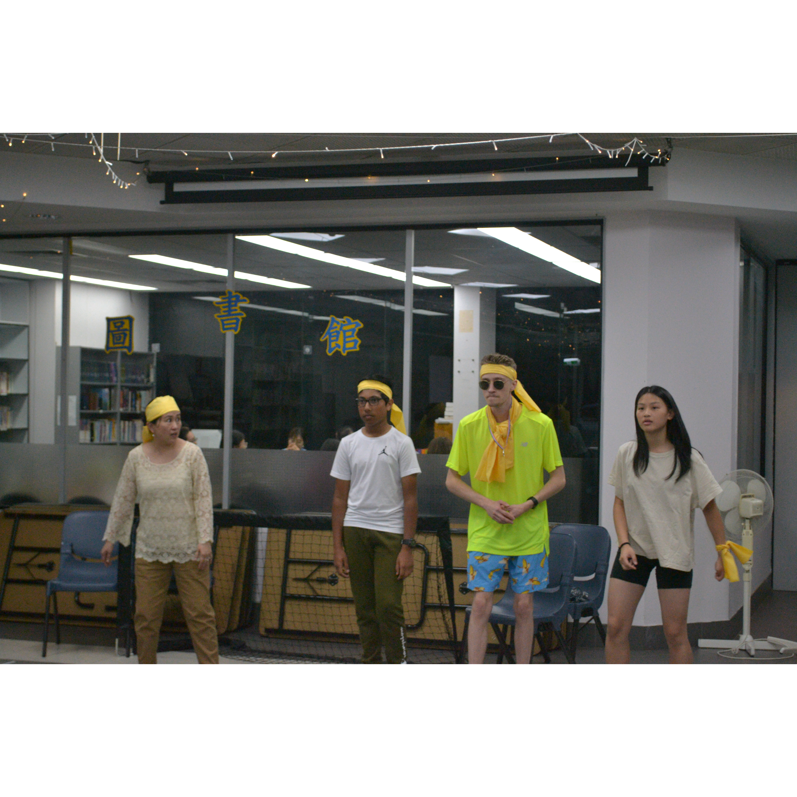
Mingle time!

